Slide 1
Advanced Sprint –Part 4
Power BI Report

Slide 2
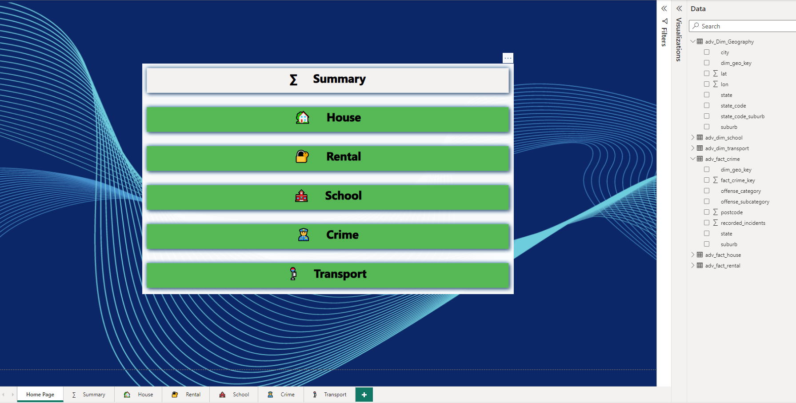
Get Data Model imported into Power BI from Data Warehouse, connect all tables on the correct columns in Power BI.

Slide 3
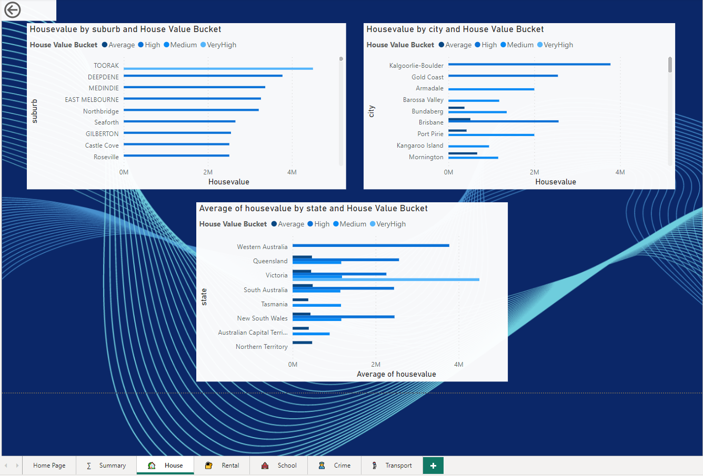
To analyze House Value from suburb, city and state, use different/multi visualizations and think about insights (e.g. House Value Buckets/Groups).

Slide 4
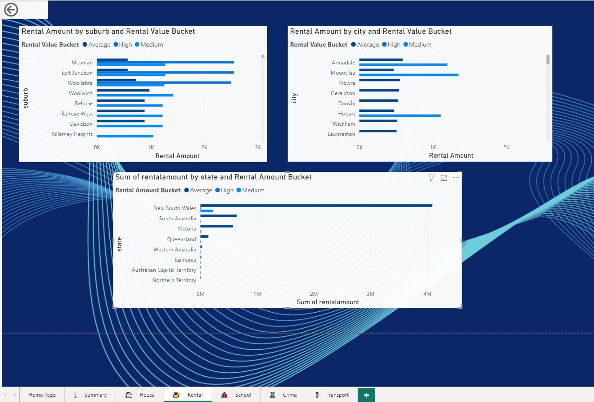
to analyze Rental Value from suburb, city and state, use different/multi visualizations and think about insights (e.g. Rental Value Buckets/Groups).

Slide 5
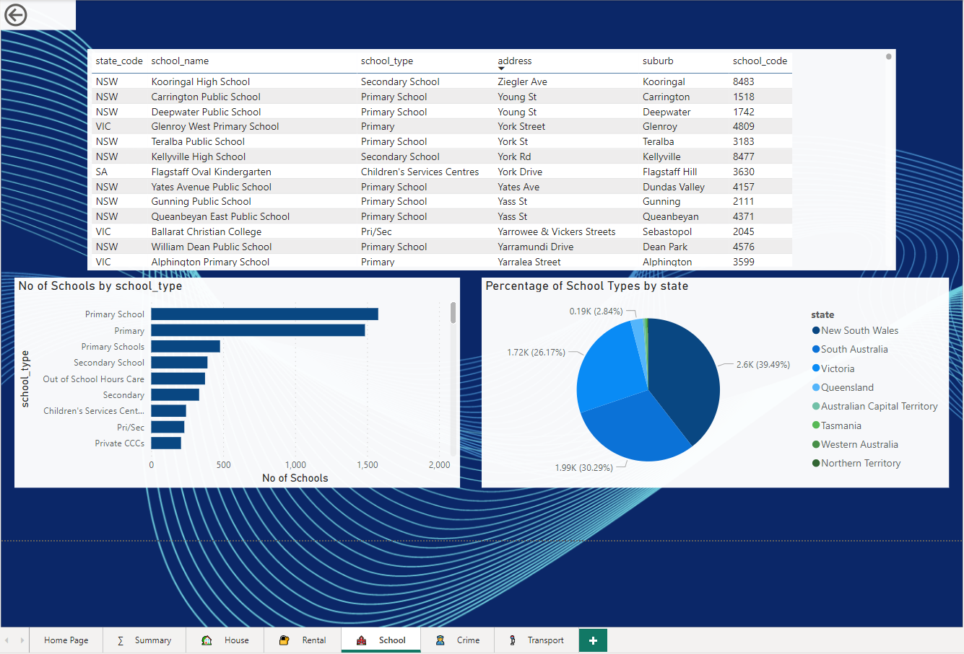
to analyze schools from suburb, city and state, use different/multi visualizations and think about insights.

Slide 6
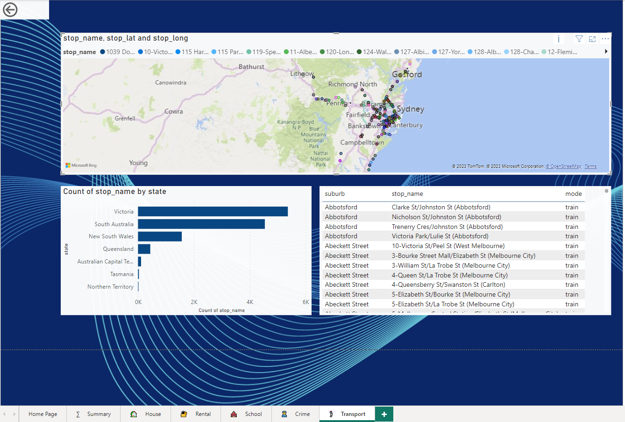
to analyze transport from suburb, city and state, use different/multi visualizations and think about insights.

Slide 7
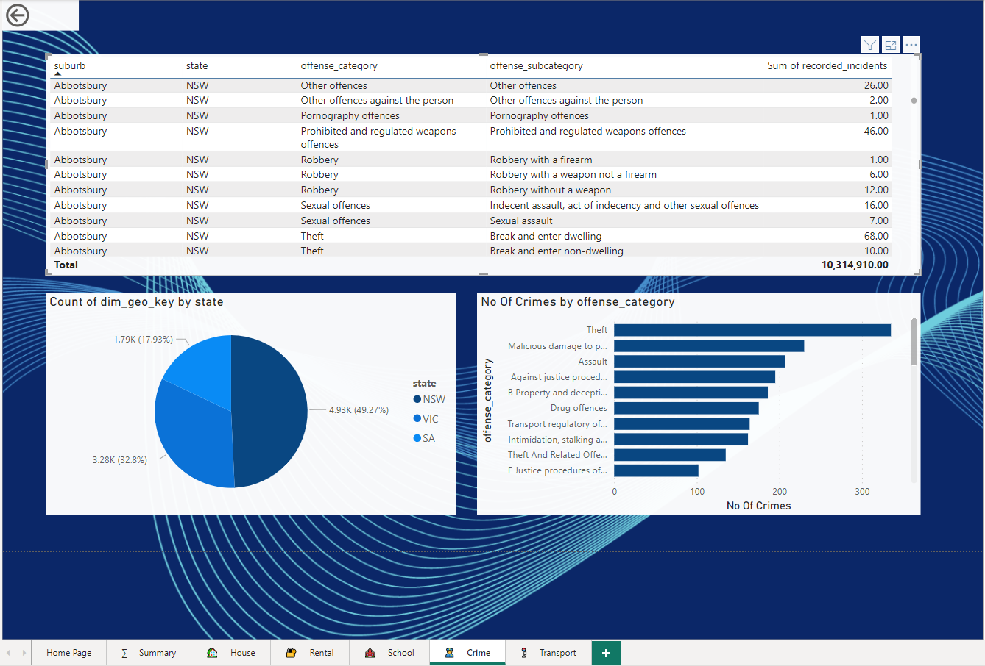
to analyze crime info from suburb, city and state, use different/multi visualizations and think about insights.

Slide 8
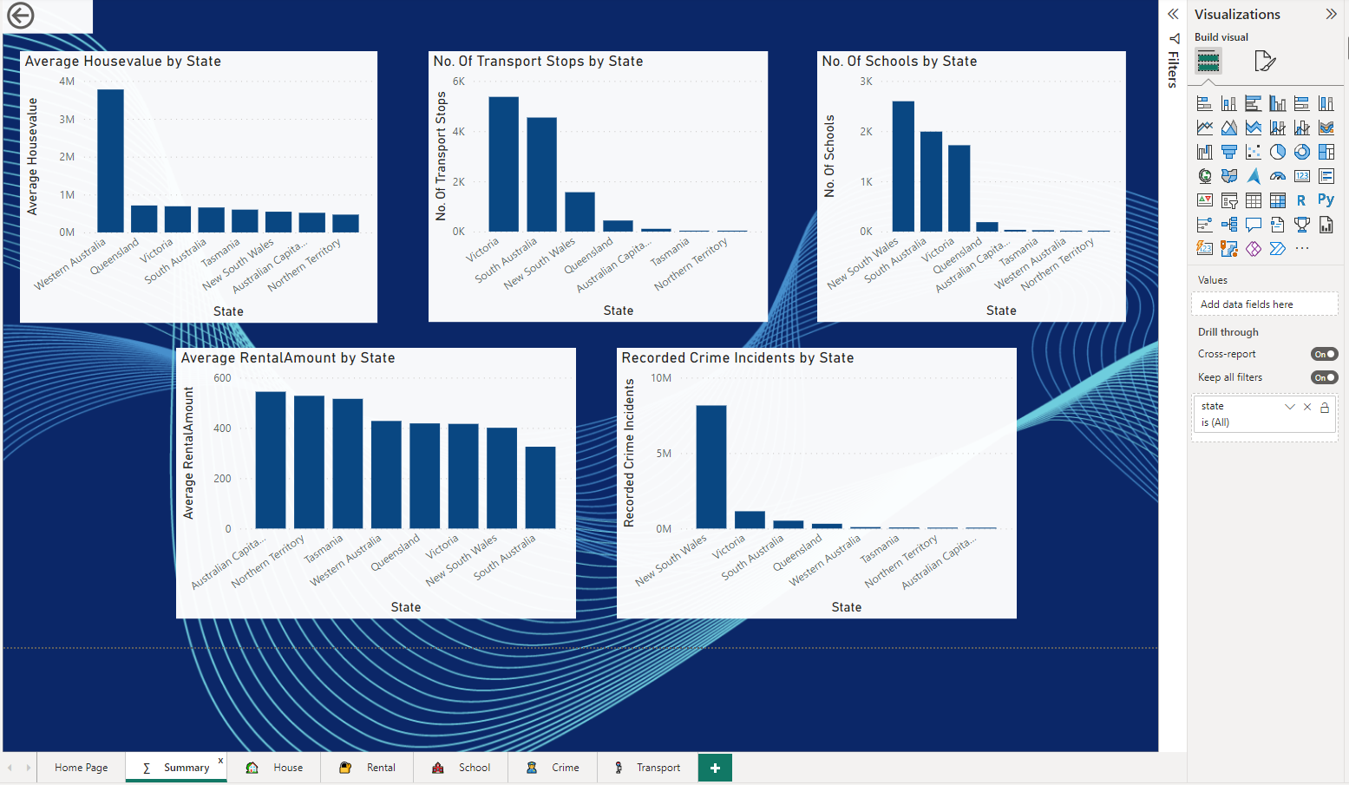
Nice to have (optional): Create a Summary page to consolidate above House Value, Rental Value, Schools, Transport and Crime info together. Put the Summary page as the first page, then to make it even better, apply drill through from Summary page to each above individual page.

Slide 9
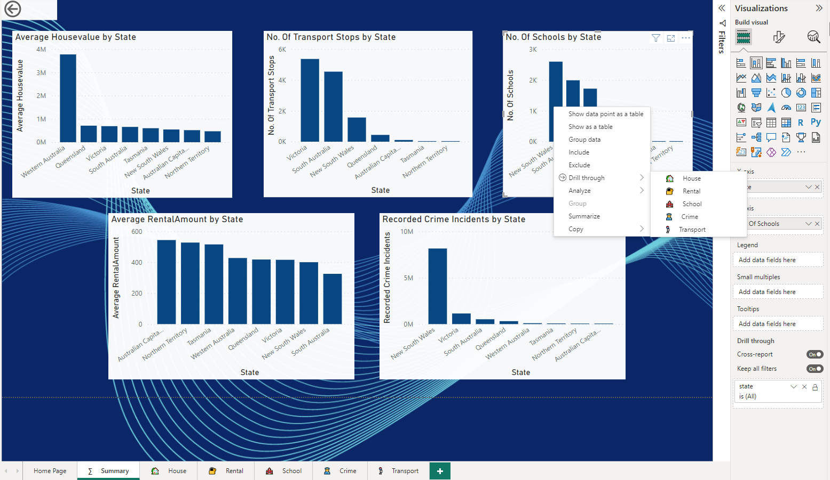
Drill through applied

Slide 10
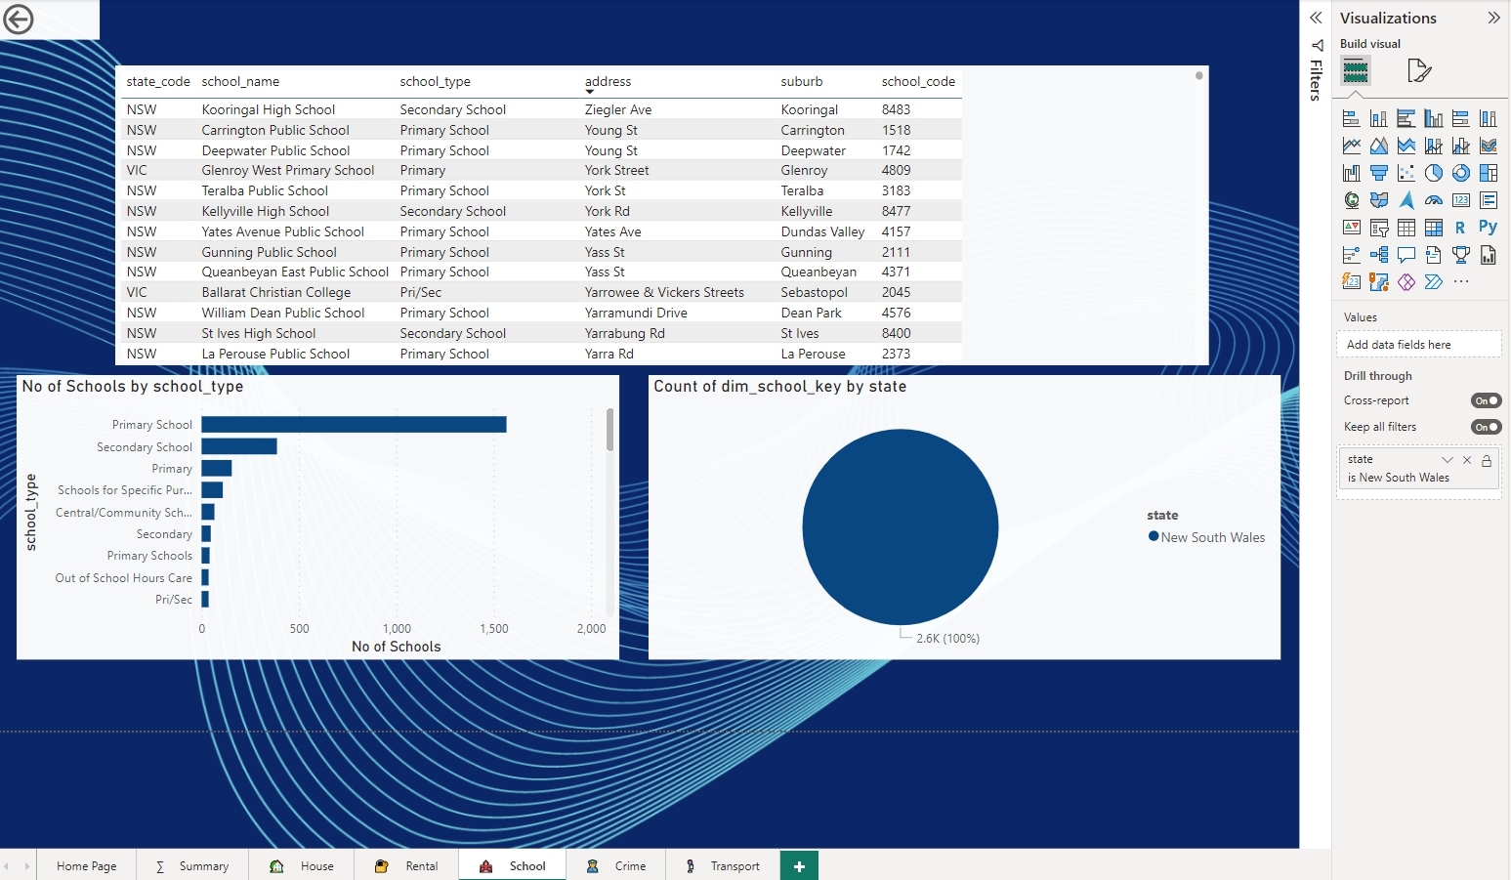

Slide 11
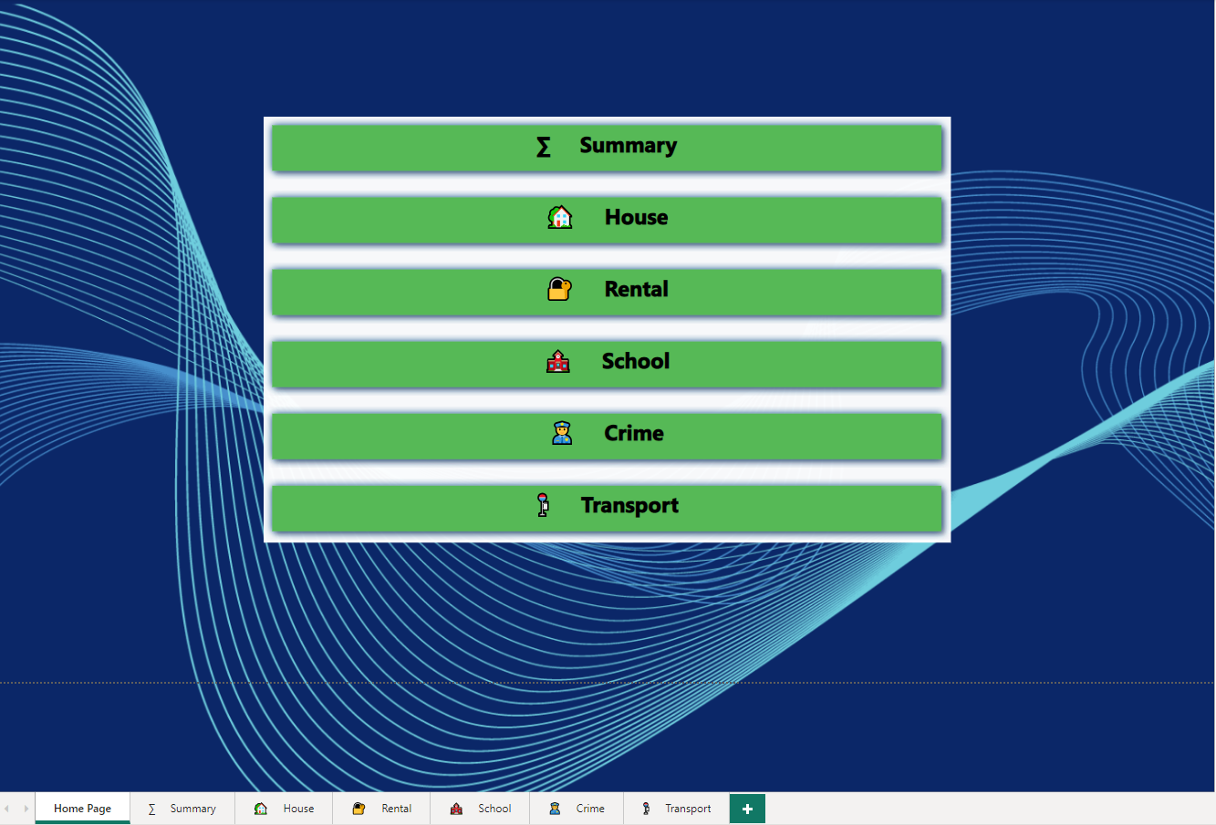
Nice to have (optional): Create a Home page for navigation, with proper images to navigate to each above individual page
Ctrl + Button on navigation page takes the user to desired page.

